Slide 1

An Online Framework for User-Based Analysis of Maps in First Person Shooters

Slide 2

What makes a video game good?
Visuals, narrative and gameplay.
Game Design
Level Design
Gameplay

Slide 3
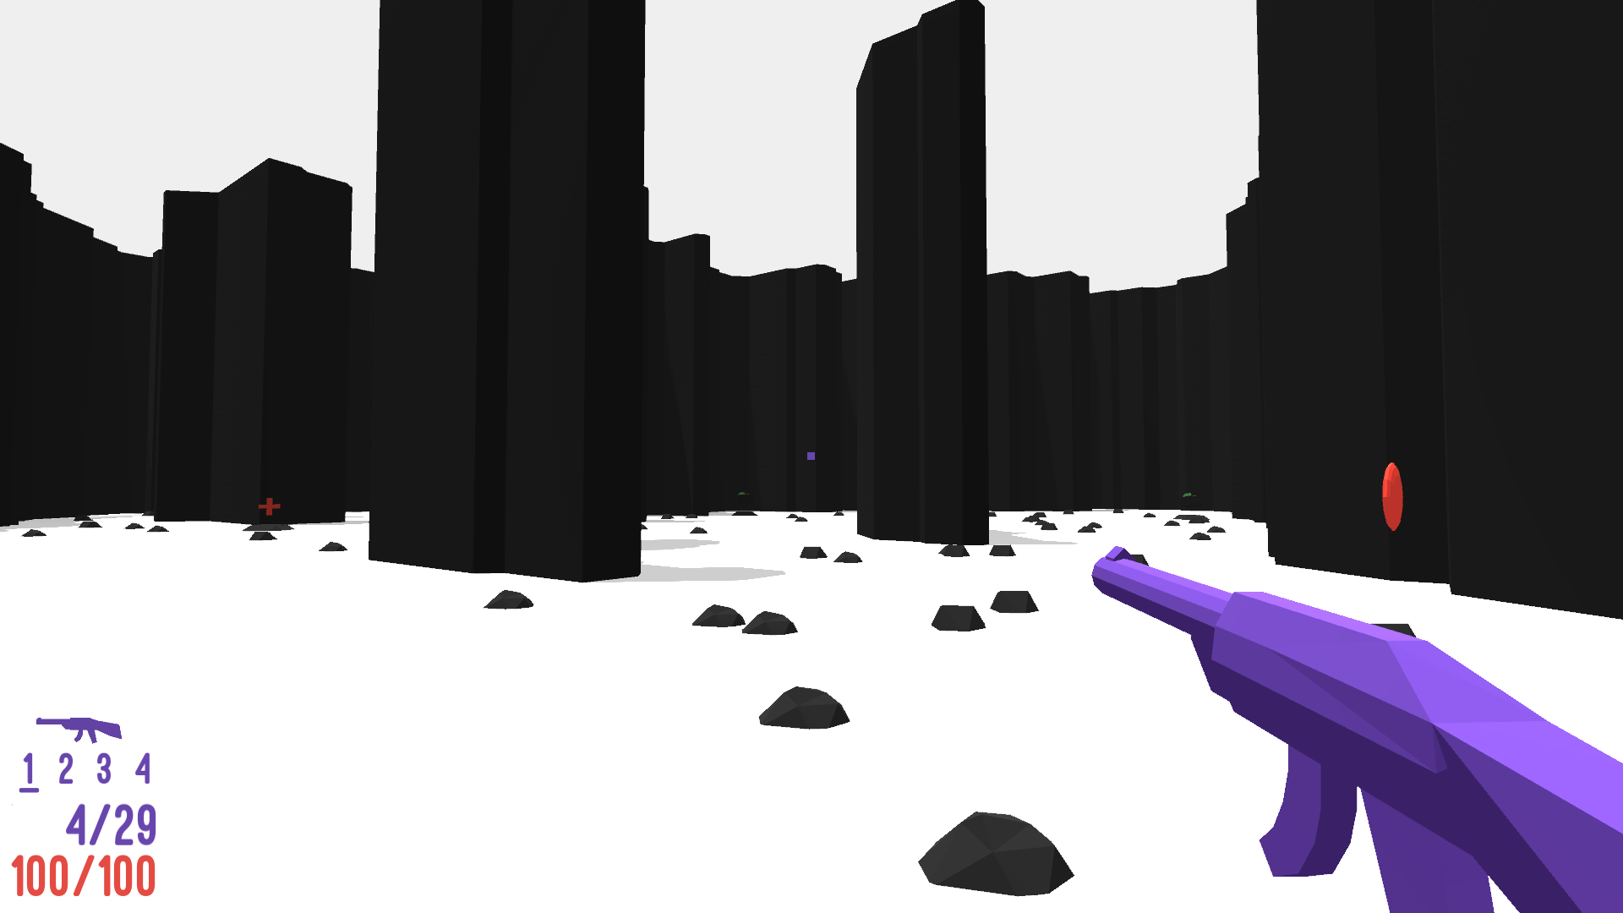

Slide 4
Research in Level Design
Two main fields: formalization of the discipline and support to the design process
Many works use Procedural Content Generation to support the design process.
The majority of these works are based on data collected from simulations.

Slide 5
Map design and generation framework
Developed to be modular, parametric and online.
Broad support to existing formats.
Easy deployment of browser playable experiments.

Slide 6

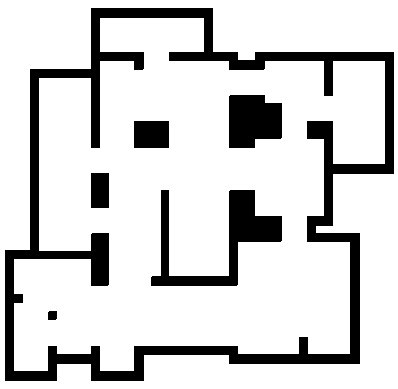

Map generation
Cellular generator
Divisive generator
Digger generator

Slide 7

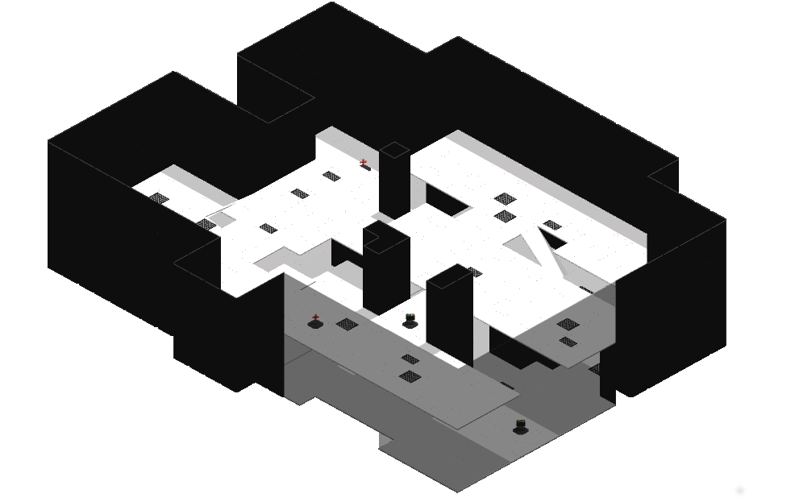
Multi-level maps
More complex multi-level maps than the ones produced in previous works.

Slide 8
Graph-based map analysis
Generate different graphs highlighting different features of the map.
Extract layout information using Graph-Theory metrics.
Use this information to analyze the map or to place game elements.

Slide 9

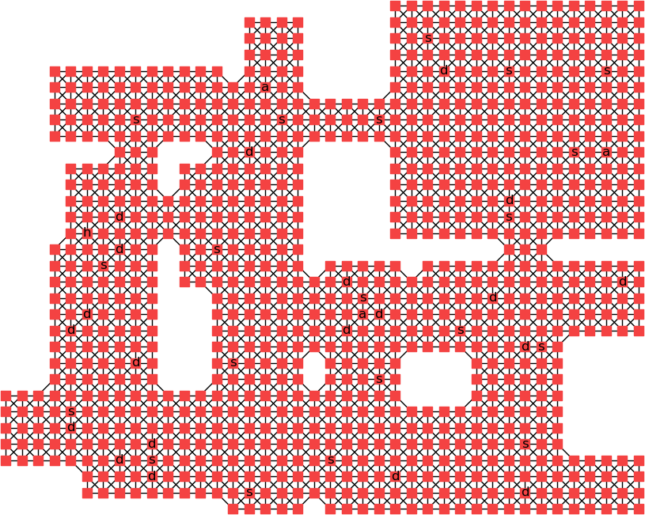
Graphs for single-level maps
Map
Tiles graph

Slide 10
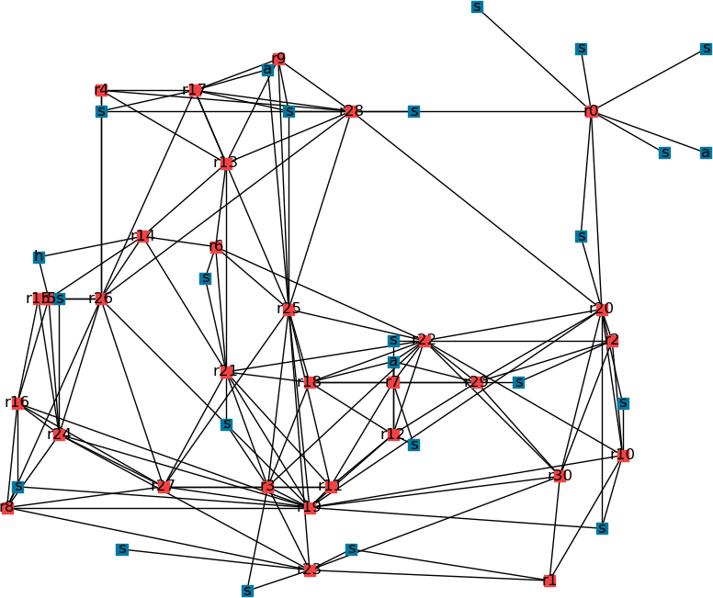
Graphs for single-level maps
Map
Rooms and game elements graph

Slide 11
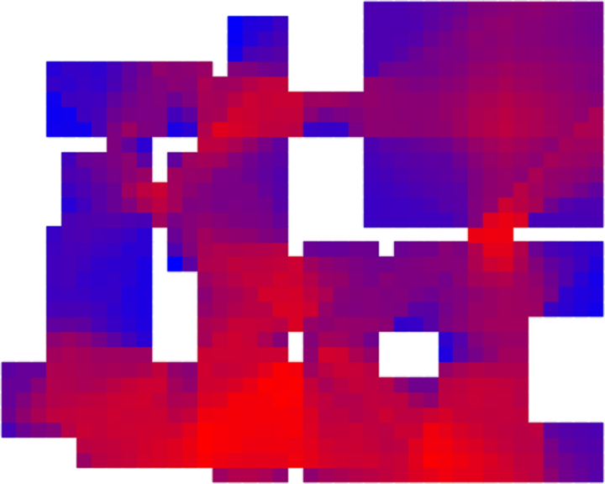
Graphs for single-level maps
Map
Visibility graph

Slide 12

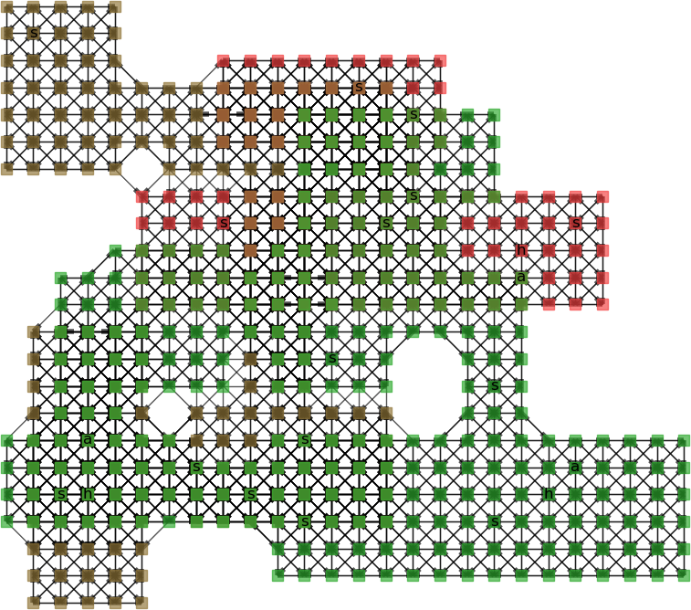
Graphs for multi-level maps
Map
Tiles graph

Slide 13
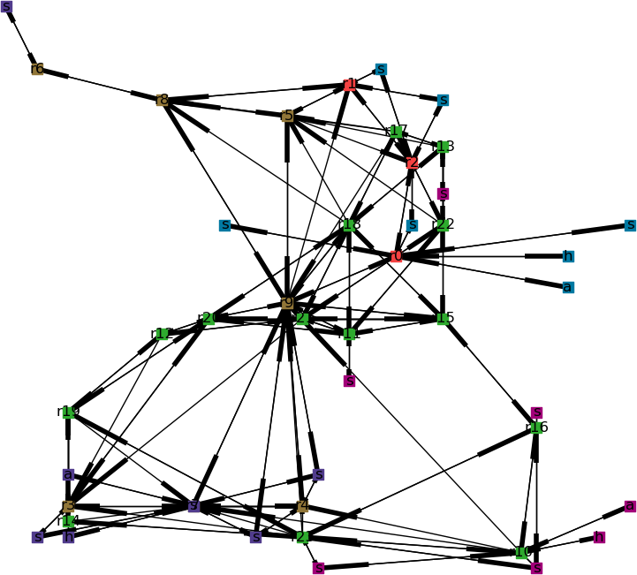
Graphs for multi-level maps
Map
Rooms and game elements graph

Slide 14
Placement of game elements on the map
Rules are defined considering the up-player vs down-player dynamic.
The selection of the room and of the tile on which to place a game element is performed in two steps.
Each selection can be performed at random, uniformly or using an heuristic.

Slide 15

Selection by heuristic
Selection of a room:
$$r^{∗}=\arg{\max_{rεR}{(w_{D}×D\left(r\right)+w_{H_{e}}×H_{e}(r))}}$$
Selection of a tile:
$$t^{∗}=\arg{\max_{tεT}{(w_{v}×v\left(t\right)+w_{h_{w}}×h_{w}(t)+w_{h_{e}}×h_{e}(t)))}}$$

Slide 16
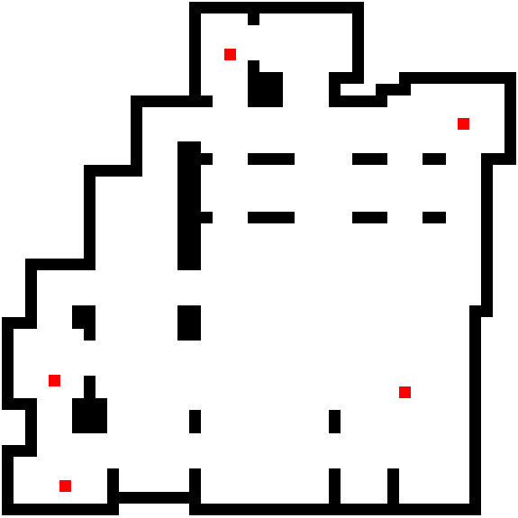

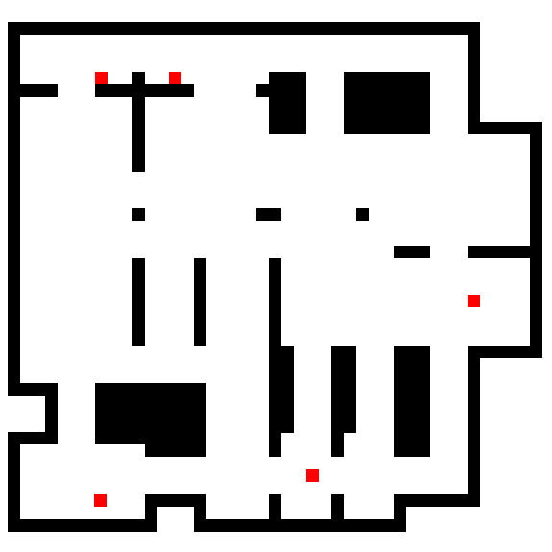
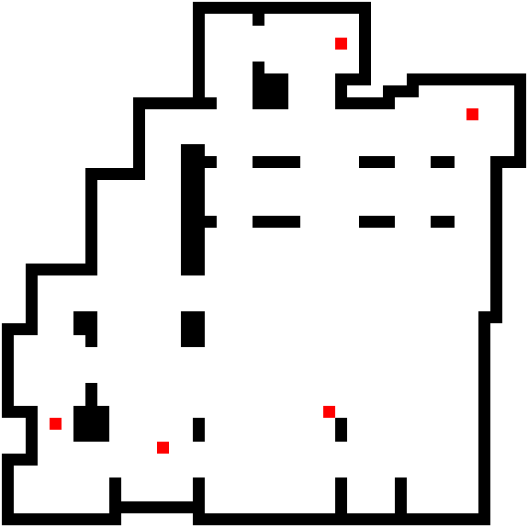
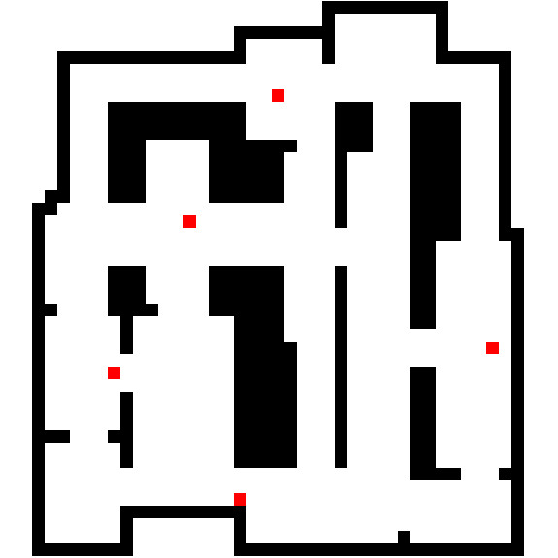
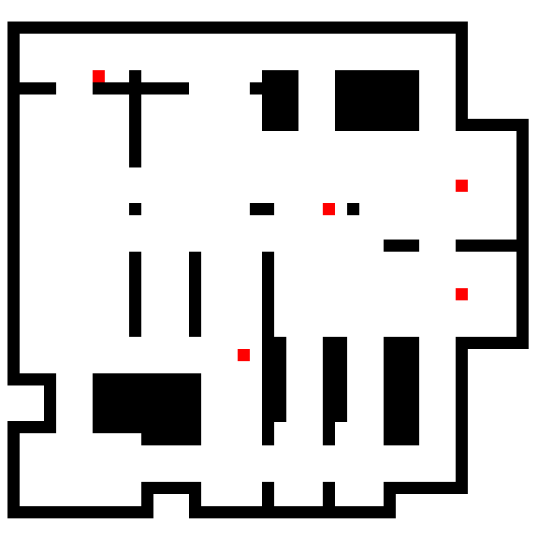
A case study: spawn points placement
Arena
Corridors
Intense
Heuristic
placement
Uniform
placement

Slide 17
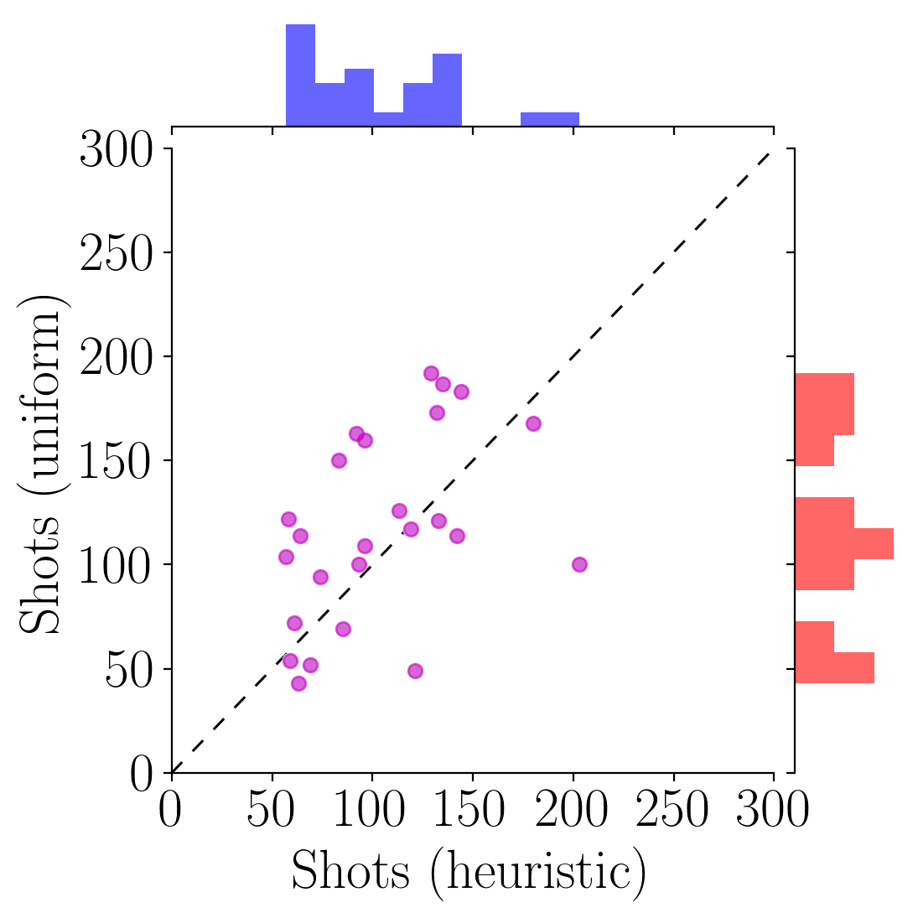
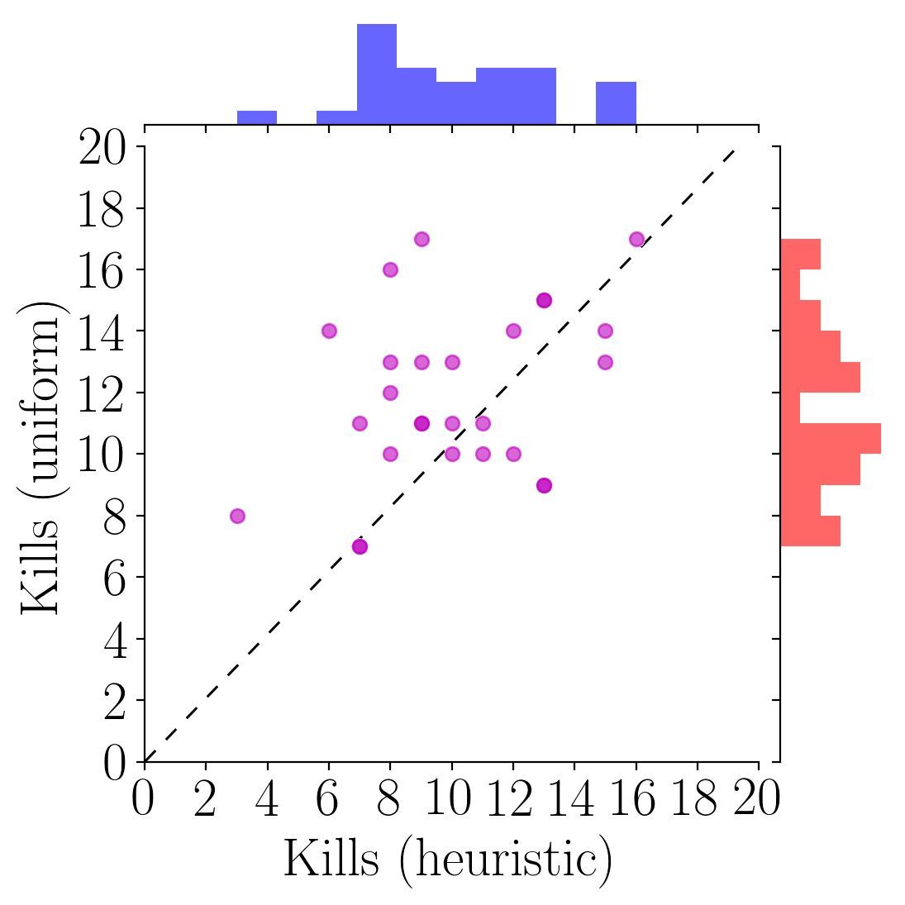
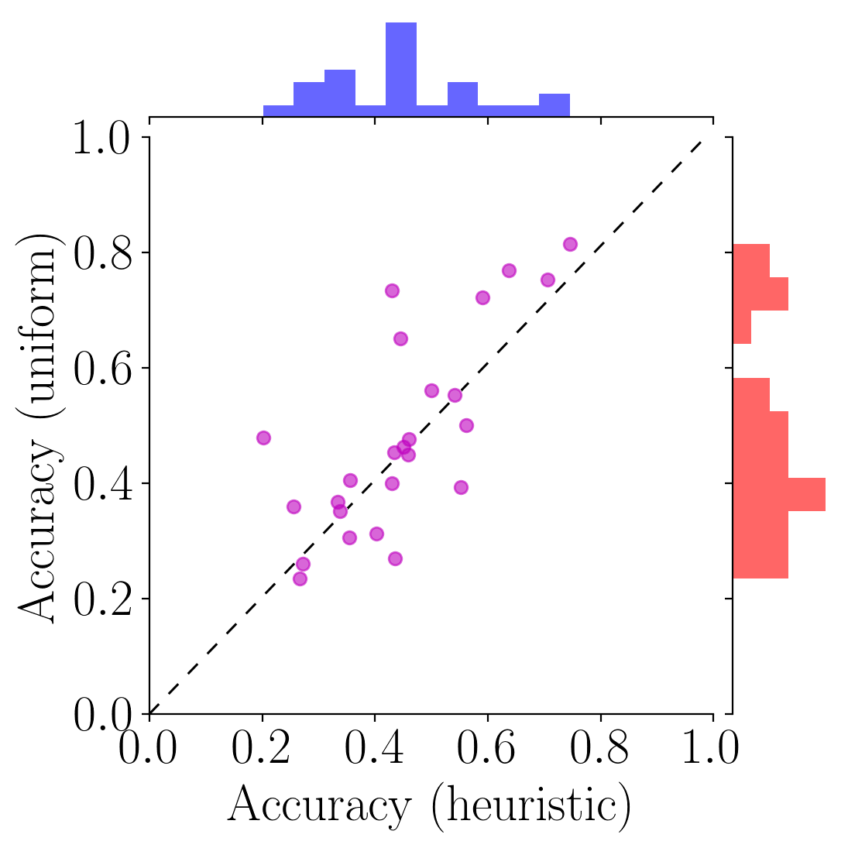
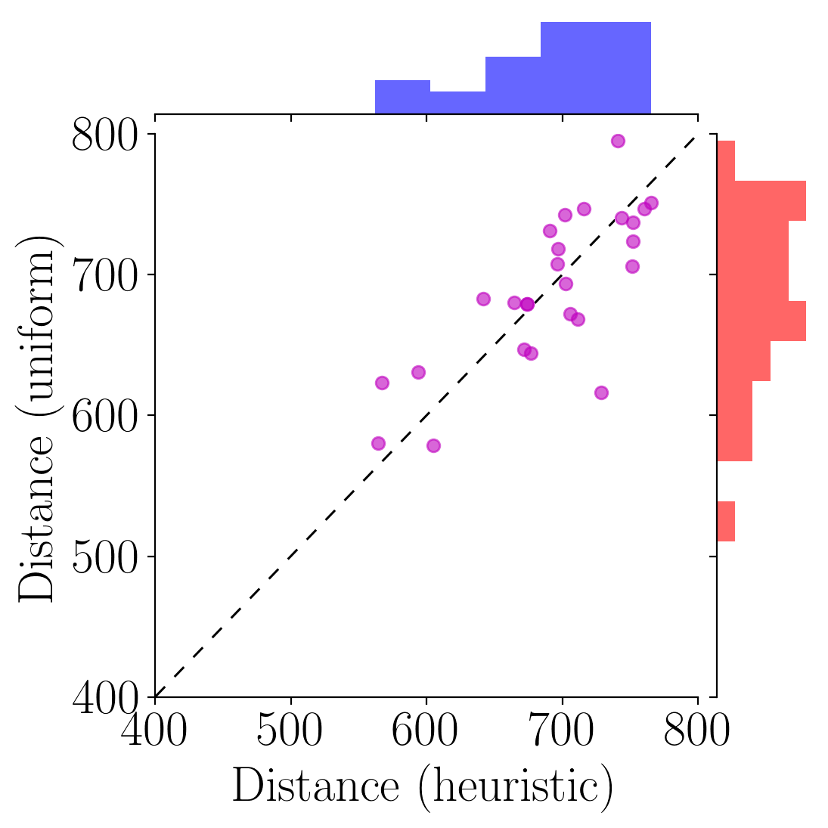

Experimental results
Spawn points placed with the heuristic approach proved harder to find than the ones placed with the uniform approach.
AvgKillTime: 26% higher for uniform approach with $α_{Wilcoxon, one tiled}=0.00203$
AvgKillDistance: 21% higher for uniform approach with $α_{Wilcoxon, one tiled}=0.01243$

Slide 18
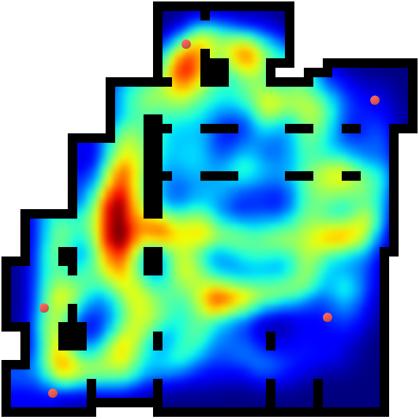
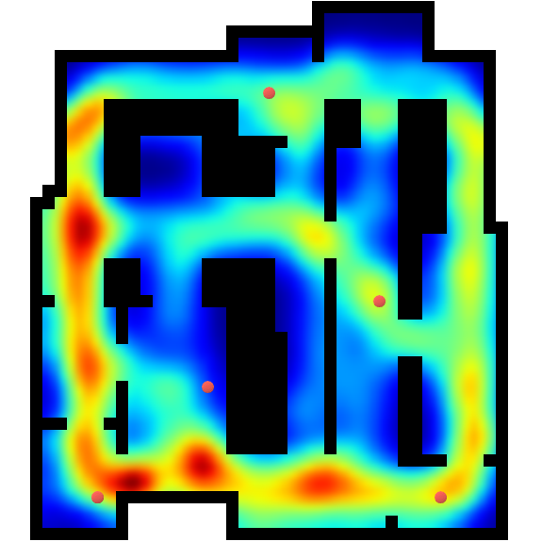
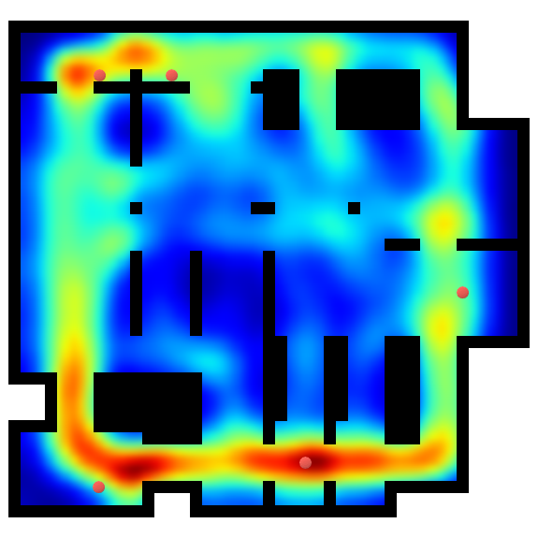
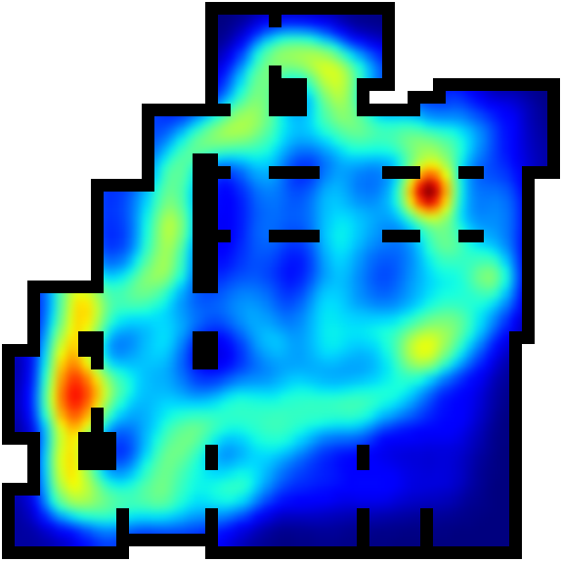
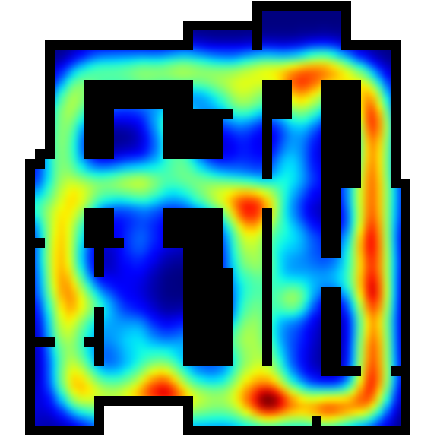
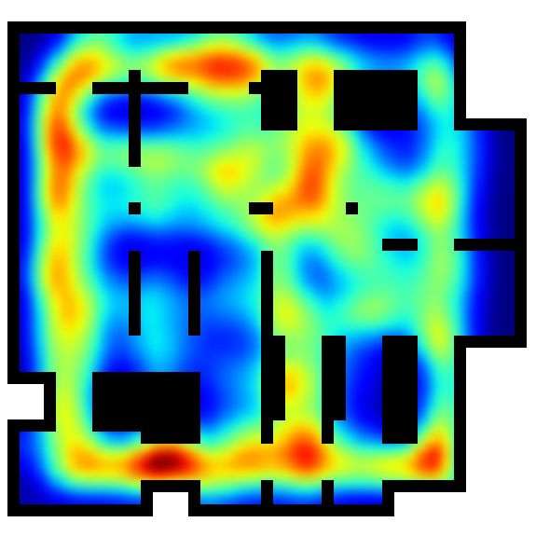
Experimental results
Heuristic
placement
Uniform
placement

Slide 19
Conclusions
The framework is effective in collecting data.
Graph Theory allows a new and interesting approach to level design analysis.
Heuristic placement based on Graph Theory allows to effectively place game elements considering their features and the topology of the map.

Slide 20
Future developments
Multiplayer and AI support.
Heuristics for weapon placement.
Design pattern analysis.

Slide 21
Thank you for your attention!

